Slide 1
Decadal Programme:
Data for the Planet:
“Making Data work for Cross-Domain Challenges
John Broome
Treasurer
CODATA
www.codata.org
GEO Week
Canberra, Australia
4-8 November 2019

Slide 2
The DATA Challenge
The digital and data revolution presents both with huge opportunities and significant challenges.
Pressing global scientific and human issues can ONLY be addressed through research across disciplines to understand complex systems - turning data into knowledge that supports action.
The ability to systematically gather data from multiple varied sources and extract information from those complex and heterogeneous data will be required.
Better exploitation of data resources for research is the epochal challenge of the 21st century and the CODATA/ISC Decadal Programme is being designed to address that challenge.

Slide 3
Decadal Programme:
Data for the Planet:
“Making Data work for Cross-Domain Challenges”
Part of the ISCs 2019-2021 Action Plan
(Part 2.1: Data-Driven Interoperability)
A partnership program to be led by CODATA for ISC involving WDS, RDA and many other national and international bodies.

Slide 4
Designing the Decadal Programme
Methodology
Designing the productive dynamic between data experts and case studies.
FAIR Digital Objects, alignment of metadata specifications and ontologies.
Engagement with concrete applications.
Partnerships:
Building partnerships with international organisations: (RDA, GO FAIR) cross-domain initiatives; research groups and centres; domain organisations etc.
Delivery Mechanisms
Fund raising.
Contribution of effort (in kind) from partners.
Distributed Programme offices.
CODATA (and other partners) Centres of Excellence.
Joint projects with partners.

Slide 5
“Making data work for cross domain challenges” Three Key Programme Activities
1: Making Data Work
Programme of technical and consensus building activities for interoperability
2: Advancing Interoperability through Cross Domain Case Studies (e.g.: Disaster Risk Reduction, Infectious diseases, Resiliant Cities)
3: International Engagement, Mobilising Domains, and Breaking Down Silos

Slide 6
Decadal Programme Structure
Central or distributed secretariat
Programme Offices / CODATA CoEs
Projects and Working Groups
Regular programme meetings and intensive workshops

Slide 7
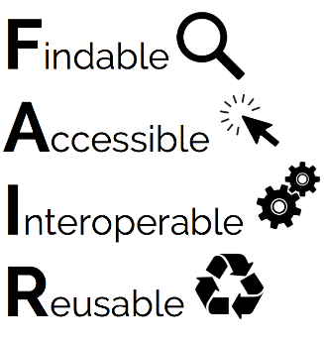
Activities “to date” Supporting Decadal Programme Development
FAIR and GoFAIR
Pilot projects investigating opportunities and barriers:
CODATA Royal Society DI Workshop (Nov. 2017)
Dagstuhl DI Workshops (Oct. 2018, Oct. 2019)
Engagement with ISC Unions interested in data best practice.

Slide 8
Programme Launch:
October 2021 at ISC General Assembly, Muscat, Oman

Slide 9
How to Become Involved
In December 2019, a call will be issued for expressions of interest in becoming a partner in the Programme. In particular, we will be looking for:
Participation in decadal programme development and pilot projects.
Hosts for Programme Offices and Centres of Expertize
Offers of in-kind contributions and funding

Slide 10
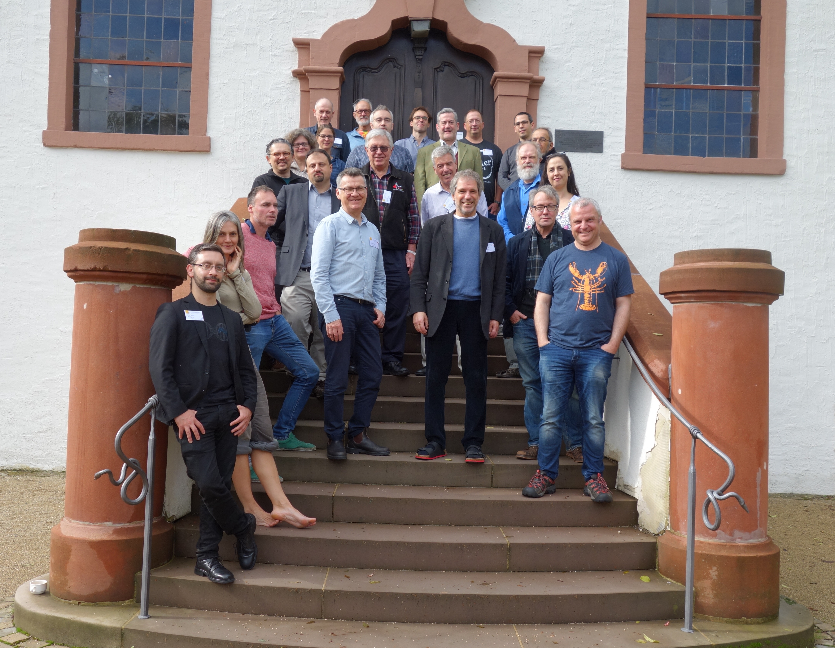
Please be part of this !

