Slide 1
AIP Disaster Management Using Single-Sign-On
Andreas Matheus by Bart De Lathouwer

Slide 2
Disaster Management – High Level Scenario
Need to bring various sources of EO data together to have situational overview and decision taking
The EO data is spread across various satellite centers and in-situ (crowd sourced) services, each (seperately) protected by potentially different technologies.

Slide 3
Disaster Management – Challenges
The user challenge
Provide username and password at worth (for this example) 4 times!
Access Rights Challenge
Potentially multiple admins must harmonize access rights to
services that are
unrelated and are
unaware of each other
Rights?
Rights?
Rights?
Rights?
Rights
Harmonization?

Slide 4
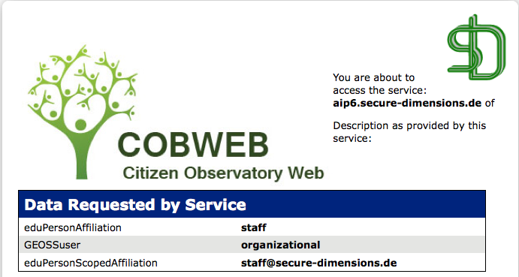
Disaster Management – One Solution
When the services are within the same access environment (federation),
the user can benefit Single Sign On
the harmonization of rights can be based on well known user attributes
Rights!
Rights!
user attributes
Rights!
Rights!
Rights
Harmonization
with user attributes

Slide 5
Disaster Management - Conclusion
With use of an Access Management Federation
Focus on the Disaster Management, not spending time looking up passwords!
Rights harmonization guarantees access to relevant (need-to-know) content!
Access Management Federation
COBWEB / AIP-6 Federation
http://cobwebproject.eu/development/welcome-page-test-federation

Slide 6
Technical work in AIP
What has been achieved
Trusted gateway for OpenID into SAML-2
Realization during AIP-7 that trust between existing authentication federations requires more sophisticated gateways to handle a multi-authentication federation solution for GEOSS
Identified open source and commercial solutions to address trust gateways that cover a large set of authentication protocols
Recommendation and Specification
Completed by December, 2015
To be delivered to IIB and GEOSec
What remains to do
Incorporate into GCI
Tutorial on deploying and using the SSO component
Could require the “new” legal entity of GEO
Notes:
1. The products are typically not open source, but still looking.

