Slide 1
CODATA Activities in Support of Data Sharing
GEO Plenary 2016
St. Petersburg, Russia
6 November 2016
John Broome
Treasurer, CODATA
www.codata.org

Slide 2
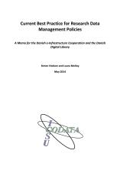
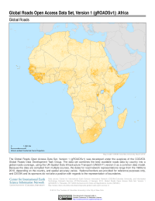
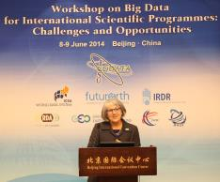
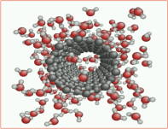
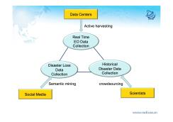
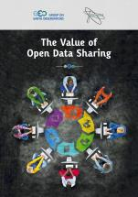
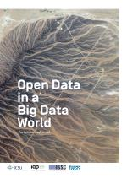
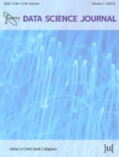
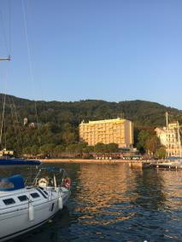
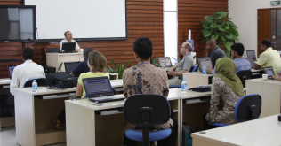
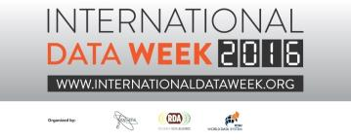
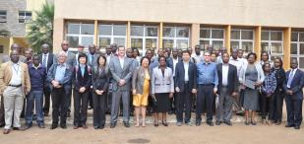
CODATA: Mobilizing the Data Revolution
3) Frontiers of Data Science
1) Principles, Policies and Practice
Data Science Journal
2) Capacity Building
SciDataCon 2016, 11-13 Sept, Denver, CO.

Slide 3
CODATA: Mobilizing the Data Revolution
3) Frontiers of Data Science
1) Principles, Policies and Practice
Data Science Journal
2) Capacity Building
SciDataCon 2016, 11-13 Sept, Denver, CO.

Slide 4
Principles, Policies and Practice:
The Value of Open Data Sharing
Report by CODATA for GEO
A concise, accessible, high-level synthesis of arguments and evidence of the benefits and value of open data sharing.
Available at http://dx.doi.org/10.5281/zenodo.33830
GEO DSWG is building on this work with further examples: would be valuable to work with this community.
Notes:
2015
Specifically at the request of the GEO Secretariat, CODATA produced a report on The Value of Open Data Sharing which provides an accessible synthesis of key arguments and evidence in favour of broad and open data sharing.
The report on the Value of Open Data Sharing was first prepared for the GEO-XII Plenary by the GEO Participating Organization CODATA (the ICSU Committee on Data for Science and Technology). Through showcasing diverse benefits of open Earth observations data, the report is designed to facilitate the process of transitioning from restricted data policies to more open policies for government data.

Slide 5
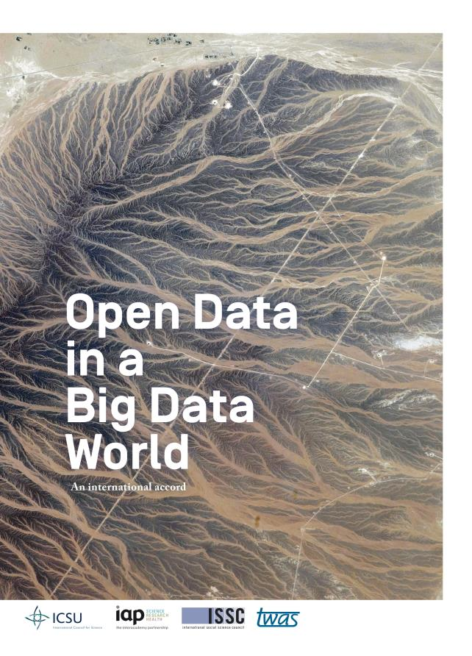
Principles, Policies and Practice:
The Case for Open Data
in a Big Data World
Endorsed by GEO
Science International Accord on Open Data in a Big Data World: http://www.science-international.org/
This document presents a powerful case that data should be open by default.
Supported by four major international science organisations.
Endorsements: over 100 organisations so far.
Notes:
2015
As a witness to the mutually supportive collaboration between CODATA, GEO has endorsed the Science International Accord on Open Data in a Big Data World, in which CODATA played the leading role.
Global Science Organizations
ICSU
InterAcademy Partnership
The World Academy of Science
Int. Social Science Council

Slide 6
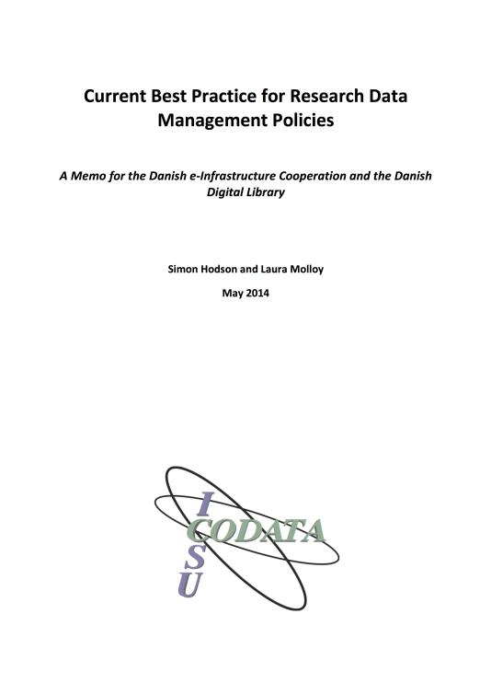
Principles, Policies and Practice:
Data Policies Assessment and Collabortion
CODATA Data Policy Committee
Register of Good Practice and Data Policy Assessment Tool
Expert Report on Data Policies: http://dx.doi.org/10.5281/zenodo.27872
Means of assisting good practice
Supporting Development of Data Strategies with:
Polish Science Ministry.
Jomo Kenyatta Univ. of Agriculture and Technology (JKUAT), Kenya
Finnish National Committee and with
Portugal, Denmark, and other countries
Notes:
2014

Slide 7
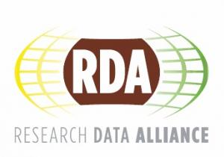
Principles, Policies and Practice:
Implementation Guidelines for the
Legal Interoperability of Research Data
Joint CODATA-RDA Interest Group on Legal Interoperability.
Facilitate the lawful access to and reuse of research data.
Determine the rights to and responsibilities for the data.
Balance the legal interests.
State the rights transparently and clearly.
Promote the harmonization of rights in research data.
Provide proper attribution and credit for research data.
Builds on work done in the context of the GEO Data Sharing Working Group.
Set of principles to help ensure the fewest possible legal barriers relating to IP to sharing research data.
Implementation guidelines .
Penultimate version of the guidelines: http://bit.ly/Legal_Interoperability_Guide
Notes:
Joint CODATA-RDA Interest Group on Legal Interoperability.
Builds on work done in the context of the GEO Data Sharing Working Group.

Slide 8
Principles, Policies and Practice:
Data Citation
CODATA Task Group on Data Citation Principles and Practices
Publication: ‘Out of Cite, Out of Mind: The Current State of Practice, Policy, and Technology for the Citation of Data’ (http://bit.ly/out_of_cite)
Background and Developments: http://bit.ly/data_citation_principles
Notes:
« Out of site out of mind » 2013

Slide 9
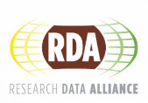
Principles, Policies and Practice:
The Challenge: Sustainable Business Models for Data Repositories
Sustaining digital data infrastructure is a major issue for science policy
Research funder policies – quite rightly – mandate data stewardship.
OECD Principles and Guidelines, 2007
G8 Science Ministers Statement, 2013
Major funders in US, UK, EC Horizon 2020 data policy etc.
Concern that current funding models will not meet the increasing need for data repositories and data stewardship.
OECD Global Science Forum Project: Sustainable Business Models for Data Repositories

Slide 10
CODATA: Mobilizing the Data Revolution
3) Frontiers of Data Science
1) Principles, Policies and Practice
Data Science Journal
2) Capacity Building

Slide 11
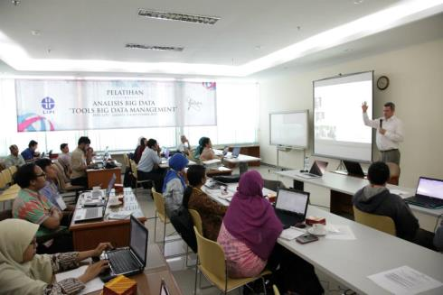
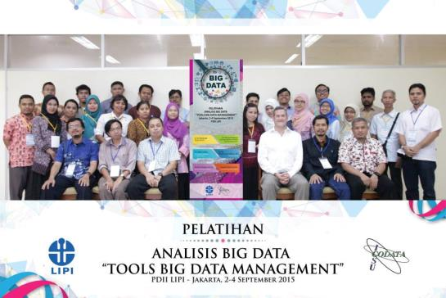
Capacity Building
Data Science Training
1) CODATA ISI Workshop on Big Data for Science, Indian Statistical Institute, Bangalore, 9-20 March 2015
http://drtc1.isibang.ac.in/bdworkshop/
2) CODATA LIPI Workshop on Big Data, Tools and Data Management, LIPI, Jakarta, 2-4 Sept 2015
http://www.codata.org/events/workshops/workshops-2015/training-workshop-on-big-data-jakarta

Slide 12
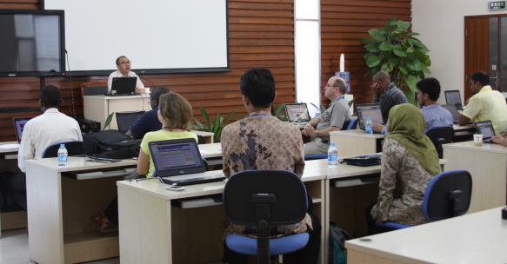
Capacity Building
Data Science Training
3) CODATA Training in Big Data for Science, Beijing, 4-20 June 2014
http://bit.ly/CODATA-China_Training_2104-Call
4) CODATA PASTD Training Workshop on Open Data, Kenya, 3-5 August 2014
http://bit.ly/codata-training-jkuat

Slide 13
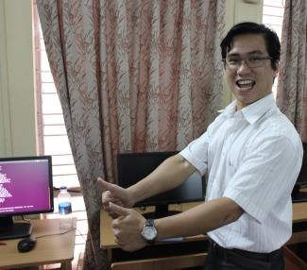
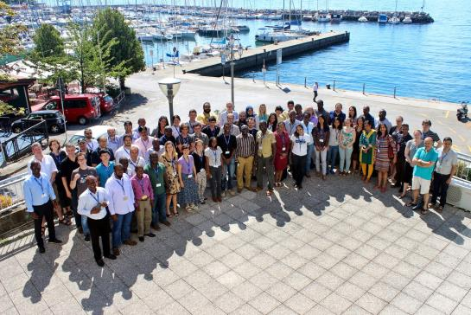
Data Science Training
5) CODATA-RDA School of Research Data Science
Principles and practice of Open Science, research data management and curation,
Development of data platforms and infrastructures,
Techniques of large scale analysis, statistics, visualisation and modelling,
Software development and data annotation.
First course: August 2016, ICTP, Trieste
Funding by ICTP, TWAS, CODATA, ACU, RDA Europe, GEO and GODAN.
Attended by 70 students from all around the world.

Slide 14
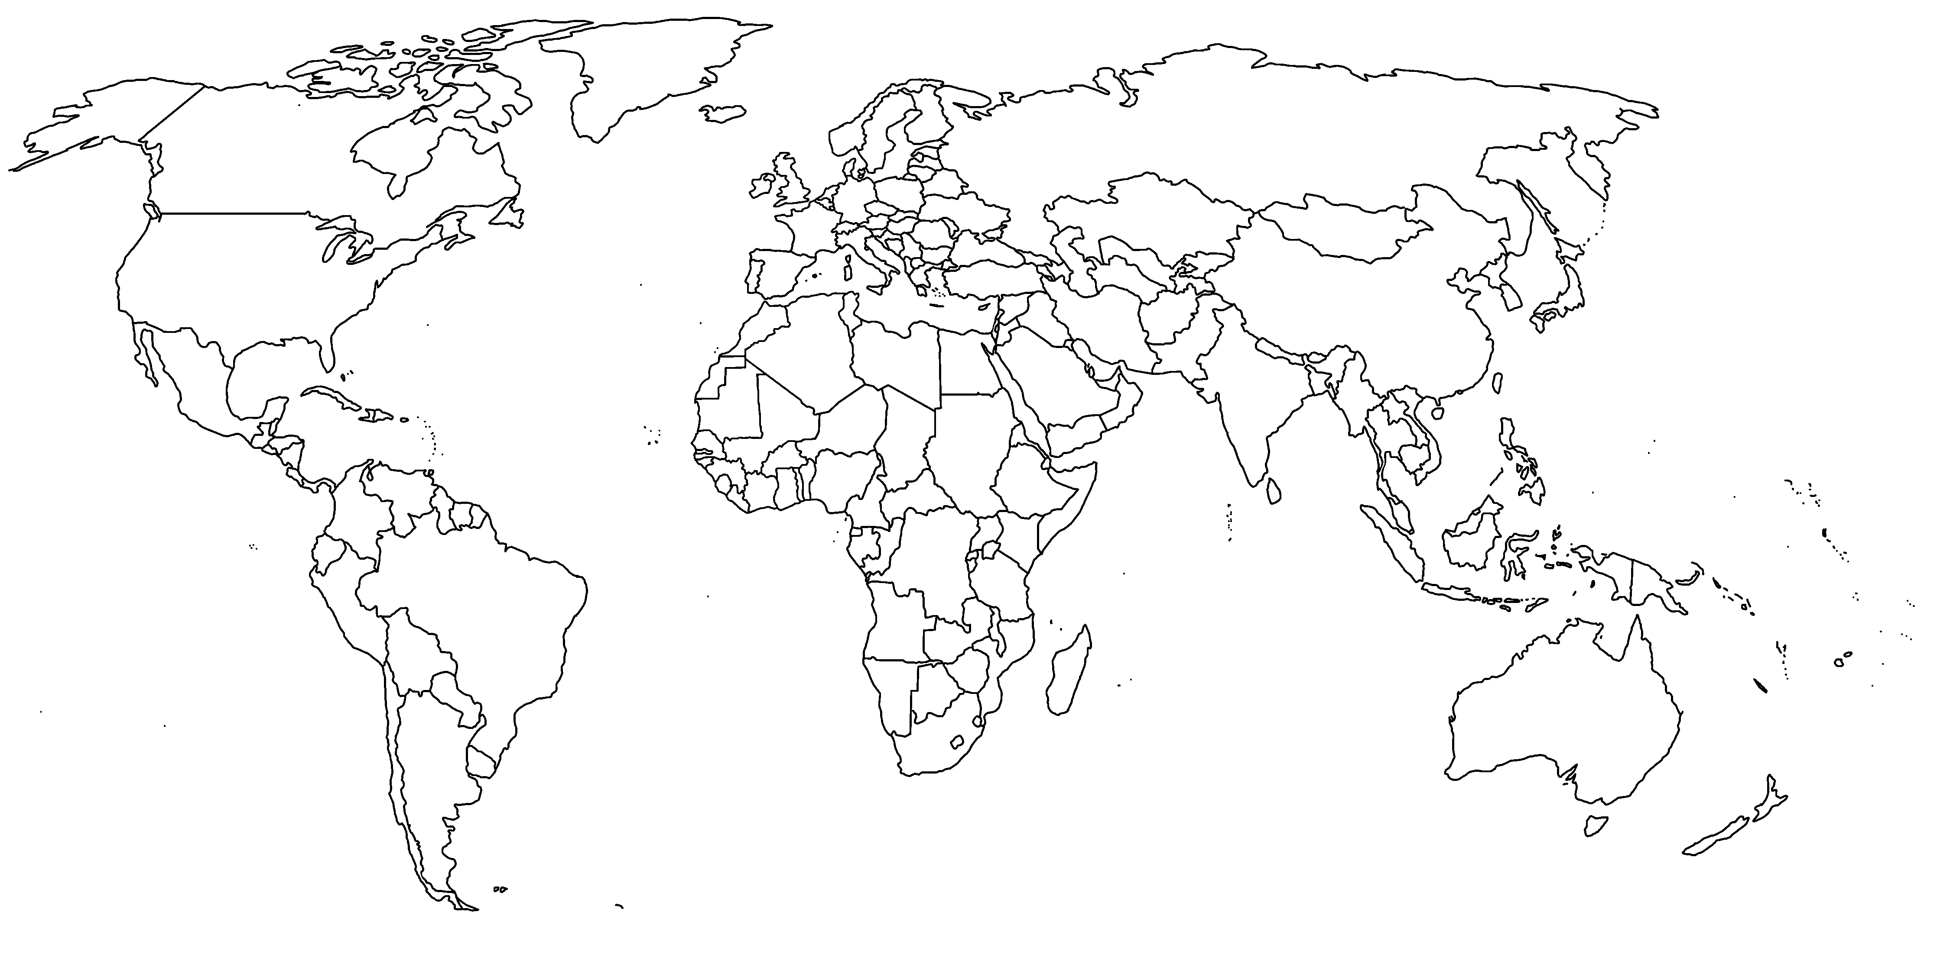
Capacity Building
Data Science Training
6) Data Citation Training Workshops
2015: China, Australia, Japan, India and South Africa.
2016: USA, Israel, Russia + Finland (Nov) and Taiwan (Dec).
2017: France, Korea, Indonesia, Brazil…
Notes:
CODATA Task Group on Data Citation ‘Data Citation: From Principles to Practice, A Focus on the Research Policy and Funding Community’: http://www.codata.org/task-groups/data-citation-standards-and-practices
Organising an international series of implementation and adoption workshops.
Promote the implementation of data citation principles in the research policy and funding communities throughout the world.
Stakeholders include: government, funders, research performing institutions, research administrators, research librarians, researchers, learned societies, publishers, data archives, journal editors …
What is the policy environment for data citation?
What are current attitudes to data citation?
What infrastructure currently exists to support data citation?
What specific plans for implementation were identified?

Slide 15
Capacity Building
Foundational Research
Data Science Curriculum
Components:
Open Science – reflection on ethos and requirements of sharing/openness
Open Research Data – Basics of data management, DMPs, RDM life-cycle, data publishing, metadata and annotation
Software Carpentry – Introduction to programming in R, the Unix shell and Git (sharing software and data)
Data Carpentry – Introduction to SQL databases
Visualisation – Tools, Critical Analysis of Visualisation
Analysis – Statistics and Machine Learning (Clustering, supervised and unsupervised learning)
Computational Infrastructures – Introduction to cloud computing, launching a Virtual Machine on an IaaS cloud
Notes:
Builds on much existing courses to create something more than the sum of its parts:

Slide 16
Frontiers of Data Science:
CODATA 2017 Eurasia Conference
Coming in October 2017
in St. Petersburg
Notes:
n 8-13 October 2017, with support from the Russian Science Foundation, CODATA, CODATA Russia, the Geophysical Center of the Russian Academy of Sciences and other partners will host the CODATA 2017 Eurasia Conference with a focus on the use of geospatially related data in important areas of research for the region.

Slide 17
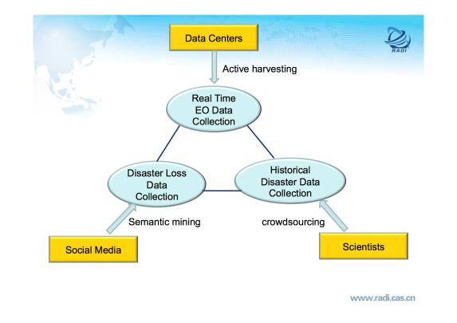
Frontiers of Data Science
CODATA Task Groups
Earth-Space Science Data Interoperability
Linked Open Data for Global Disaster Risk Research
1) Second edition of Atlas of the Earth’s
Magnetic Field
http://bit.ly/atlas-magnetic-field
White Paper: ‘Gap Analysis on Open Data Interconnectivity for Global Disaster Risk Research’ http://bit.ly/White_Paper-LOD_Disaster_Gap_Analysis
Important response from the perspective of science and data to post-Sendai framework
Inviting comments until 30 September.
2) Standards for multidisciplinary GIS for geoscience data
3) Address interoperability issues.
4) Conferences and training activities :
“Geophysical Observatories, Multifunctional GIS and Data Mining”, Kaluga, 2013.
“The Atlas of the Earth’s Magnetic Field”, Second Edition, Paris, 2015.
“School for System Analysis and Seismic Hazard Assessment”, Moscow, 2016.
“Data Intensive System Analysis for Geohazard Studies”, Sochi, 2016.
Notes:
Every 2 years, CODATA puts aout a call for TGs and at the GA CODATA members select approximately 1o that will be supported.
2 Groups
Linked Open Data for Global Disaster Risk Research (LODGD)
References : GEO data sharing principle:

Slide 18
Thank You for your Attention !

